Slide 1
Figures for Slack Explore Mem

Slide 2
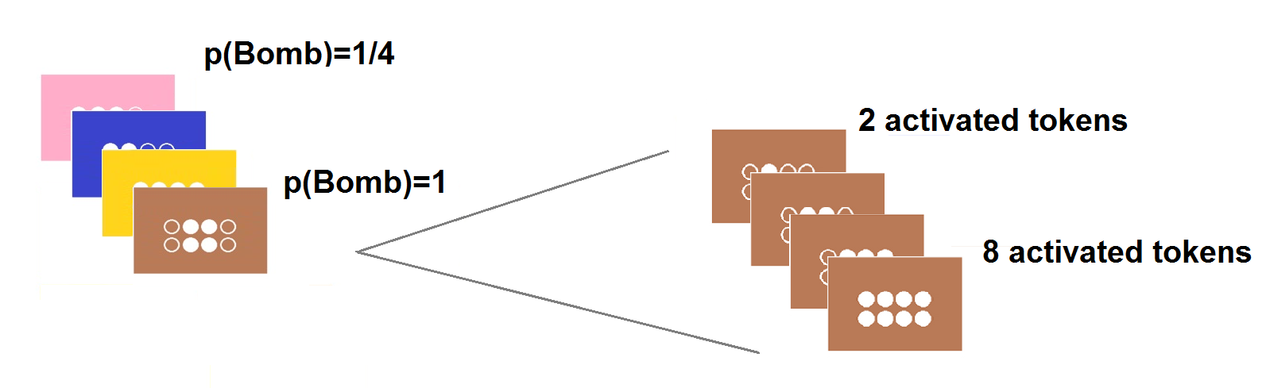
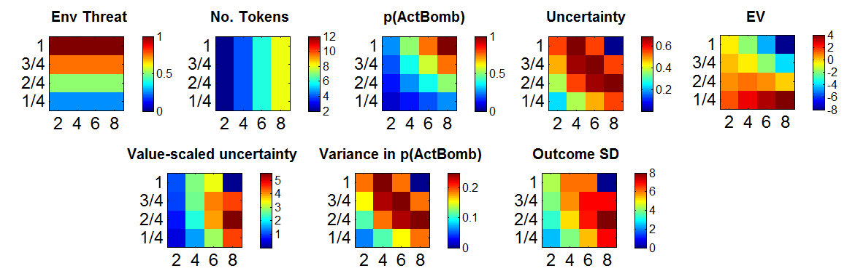
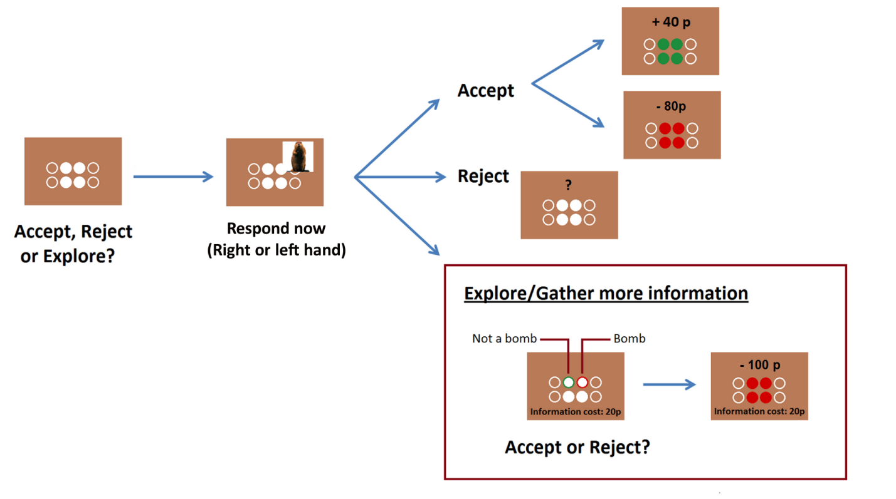
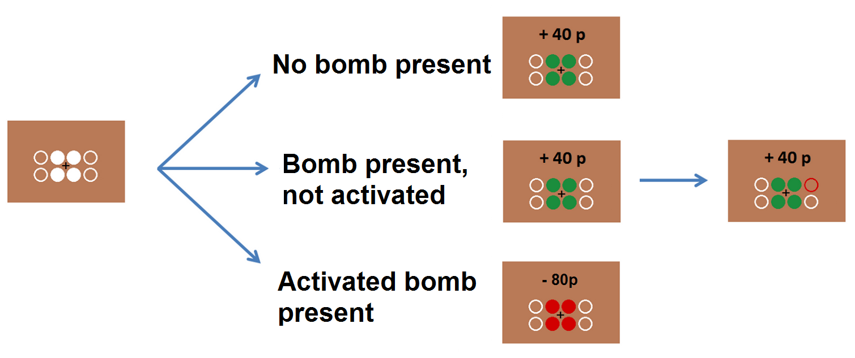
Figure 1: Experimental paradigm. Subjects faced a series of gambles, that comprised different combinations of four background colours and numbers of activated tokens (A). Subjects had to combine information from the environmental threat (background colour) andthe number of tokens to estimate the probability of an activated bomb [p(ActBomb)] on each trial (B). We were able to characterize the 4x4 task space in terms of the probablistic outcome, as well as in terms of several quantities that subjects may have used in determining whether or not to explore (B). On each trial, subjects made choices (accept, reject or explore) to each gamble, after seeing a picture of an object onscreen (choice/encoding stage; C). Before this choice/encoding stage, subjects first learned the probabilistic outcomes associated with each gamble, by passively observing its outcomes (D).
B
A
p(Activated Bomb) = p(Bomb planted) x p(Bomb activated| planted)
Background colour → p(Bomb planted)
No. of Activated tokens → p(Bomb activated| planted)
→ Amount of money you can win (10p/token)
C
D
Notes:
To generate the plots for the design, look at acquisition script exp_1SetupInstruc

Slide 3
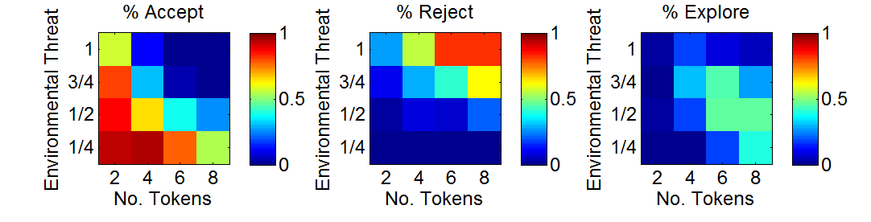
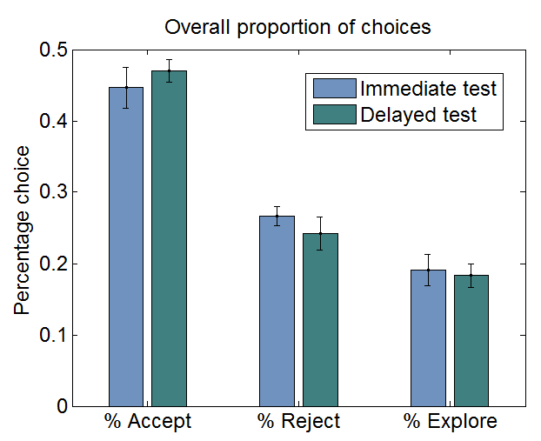
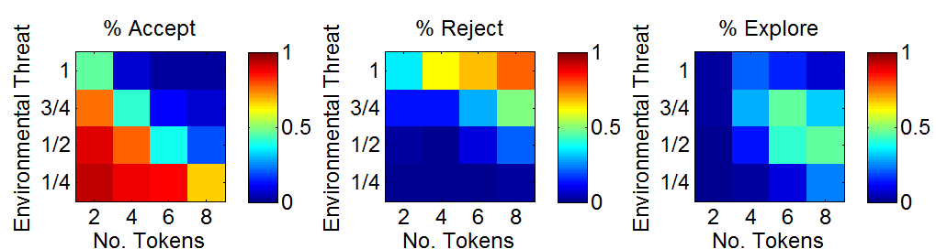
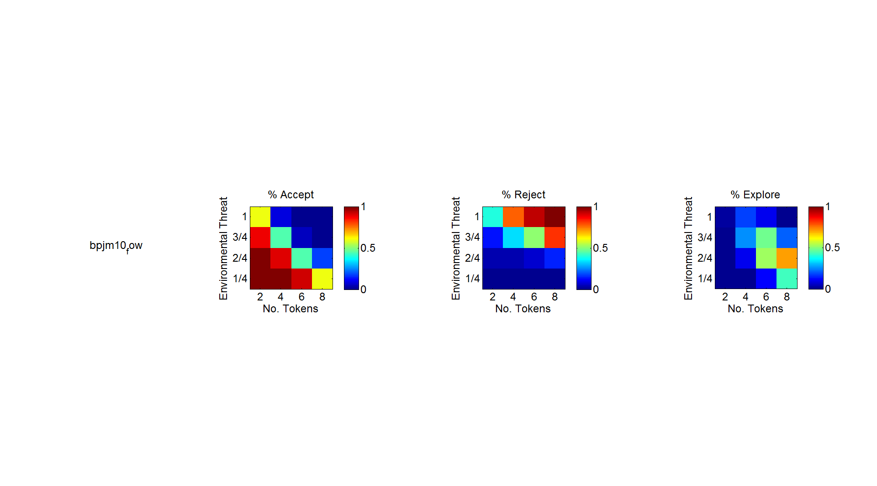
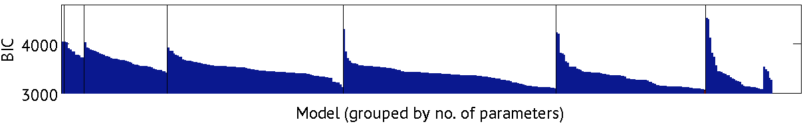

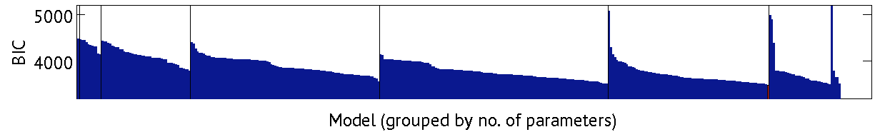
Figure 2: Behavioural choice. Distributions of accepting, rejecting and exploring across the 4x4 task space, for each memory test condition (A). Grey crosses indicate cells that were included in the analysis comparing memory for objects on explore vs non-explore trials (see Results for detail). The overall amount of accepting, rejecting and exploring did not significantly differ between the immediate and delayed memory test conditions (B). We used behavioural modelling to characterize choice across the 4x4 task space (BICs for entire model space shown in C), and the winning model (BIC indicated by the red arrows) reproduced the observed patterns of choice fairly accurately (D).
A
B
Immediate memory test
x
x
x
x
x
x
Delayed memory test
x
x
x
x
x
x
D
C
Immediate memory test
Delayed memory test
Notes:
ExploreOr inclusion criteria: p(Explore)>0.25

Slide 4
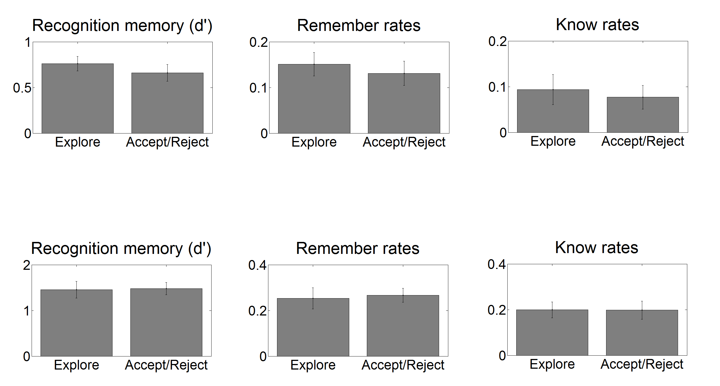
Figure 3: Effect of exploratory choice on subsequent recall. No significant differences were found comparing memory for objects that were encountered in the context of an explore versus a non-explore (accept/reject) choice, for any of the memory measures tested. This was the case both for memory that was tested immediately after encoding (top), as well as memory that was tested after a five-day delay (bottom).
Immediate memory test
Delayed memory test
Notes:
ExploreOr inclusion criteria: p(Explore)>0.25

Slide 5
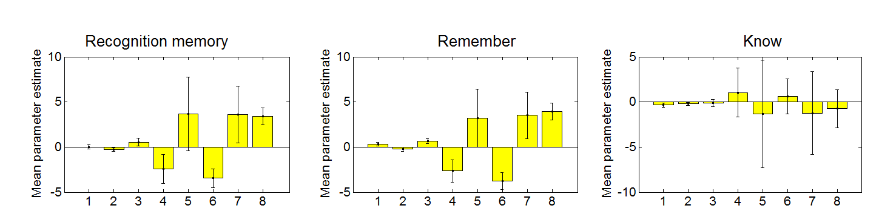
Figure 5: Effect of learning-related quantities on immediate memory. Value-scaled uncertainty significantly improved overall recognition, confident recognition, as well as the likelihood that an object would be ‘remembered’ as being old (as opposed to merely being recognized as familiar). Additionally, uncertainty and environmental threat both influenced the likelihood that an object would be remembered (negatively and positively, respectively).
**
**
*
**
**
Choice: Reject
Choice: Explore
Environmental Threat
No. Tokens
p(Loss)
Uncertainty
EV
Value-scaled uncertainty
Choice: Reject
Choice: Explore
Environmental Threat
No. Tokens
p(Loss)
Uncertainty
EV
Value-scaled uncertainty
Choice: Reject
Choice: Explore
Environmental Threat
No. Tokens
p(Loss)
Uncertainty
EV
Value-scaled uncertainty
Notes:
J parameter has been applied to distort all variables in the task space. Omitting this distortion doesn’t change the pattern of results much (except for Position recall)

Slide 6
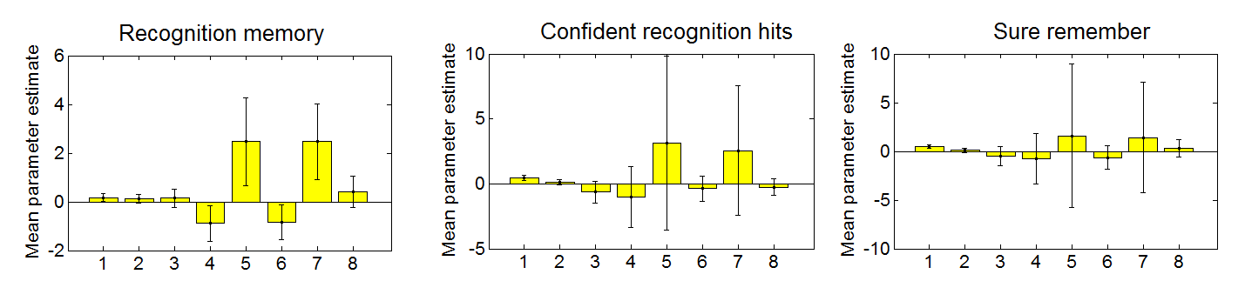
Figure 4: Effect of learning-related quantities on delayed memory. Unexpectedly, value-scaled uncertainty did not significantly influence memory when tested after a five-day delay. Instead, objects that were encountered in the context of a ‘reject’ decision were more likely to be confidently recognized as well as confidently remembered.
*
*
Choice: Reject
Choice: Explore
Environmental Threat
No. Tokens
p(Loss)
Uncertainty
EV
Value-scaled uncertainty
Choice: Reject
Choice: Explore
Environmental Threat
No. Tokens
p(Loss)
Uncertainty
EV
Value-scaled uncertainty
Choice: Reject
Choice: Explore
Environmental Threat
No. Tokens
p(Loss)
Uncertainty
EV
Value-scaled uncertainty

Slide 7
END
Table 4: Effects of psychological variables on delayed memory
Dashes indicate non-significant results (p>0.05)
Table 3: Effects of psychological variables on subsequent memory (immediately tested)
Dashes indicate non-significant results (p>0.05)
 | Recognition hit | Confident recognition | Remember | Know | Sure remember
Choice – Reject | - | t(13)= 2.25, p=0.044 * | - | - | t(13)= 2.52, p=0.027 *
Choice – Explore | - | - | - | - | -
Env Threat | - | - | - | - | -
No. Tokens | - | - | - | - | -
p(Loss) | - | - | - | - | -
Uncertainty | - | - | - | - | -
EV | - | - | - | - | -
Value-scaled uncertainty | - | - | - | - | -
 | Recognition hit | Confident recognition | Remember | Know | Sure remember | Sure know
Choice – Reject | - | - | - | - | - | -
Choice – Explore | - | - | - | - | - | -
Env Threat | - | - | t(12)= 2.4, p=0.035 * | - | - | -
No. Tokens | - | - | - | - | - | -
p(Loss) | - | - | - | - | - | -
Uncertainty | t(12)= -3.35, p=0.006 ** | t(12)= -2.81, p=0.017 * | t(12)= -4.03, p=0.002 ** | - | t(12)= -2.73, p=0.020 * | -
EV | - | - | - | - | - | -
Value-scaled uncertainty | t(12)= 3.57, p=0.004 ** | t(12)= 3.67, p=0.004 ** | t(12)= 4.18, p=0.002 ** | - | t(12)= 3.44, p=0.005 ** | -

